Slide 1

UNIT - 6

Slide 2
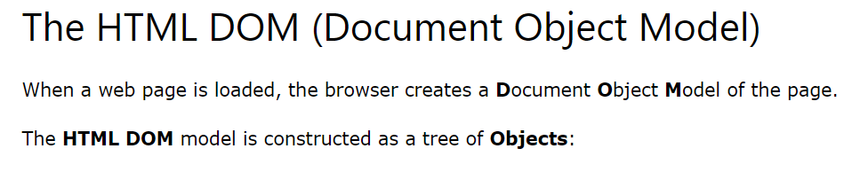
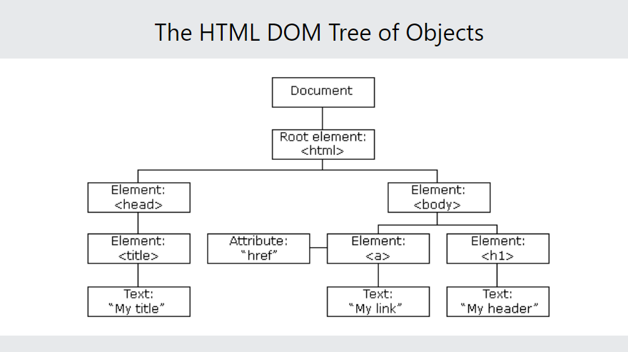

Slide 3
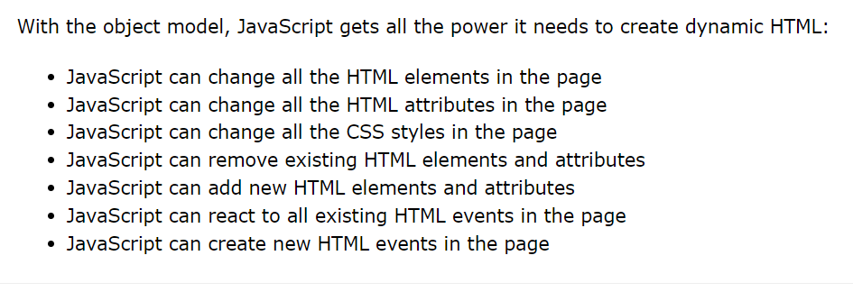

Slide 4
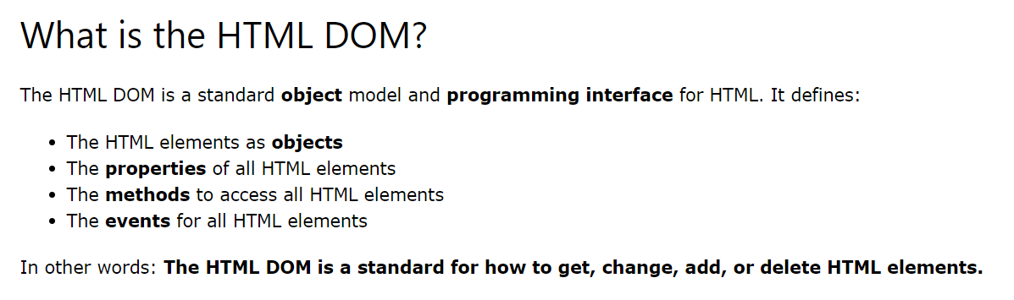
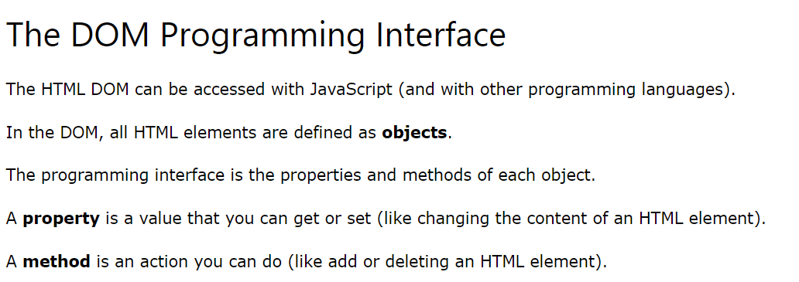

Slide 5
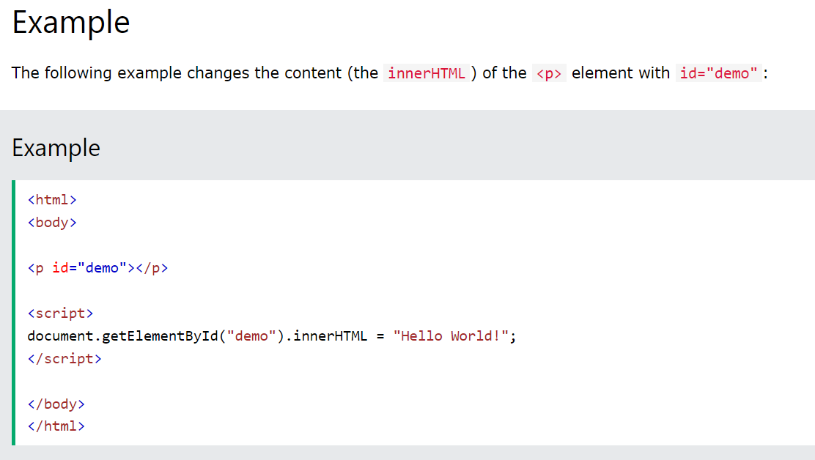
In the example above, getElementById is a method, while innerHTML is a property.

Slide 6
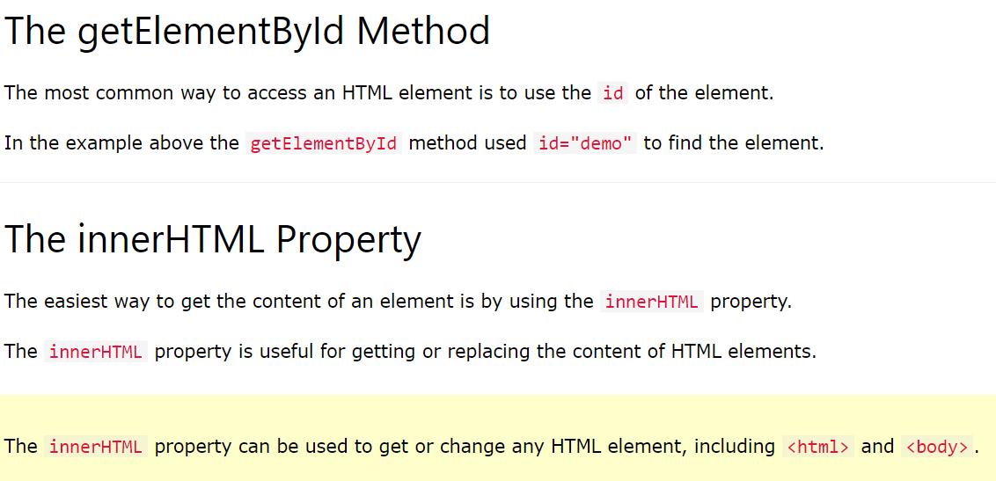

Slide 7
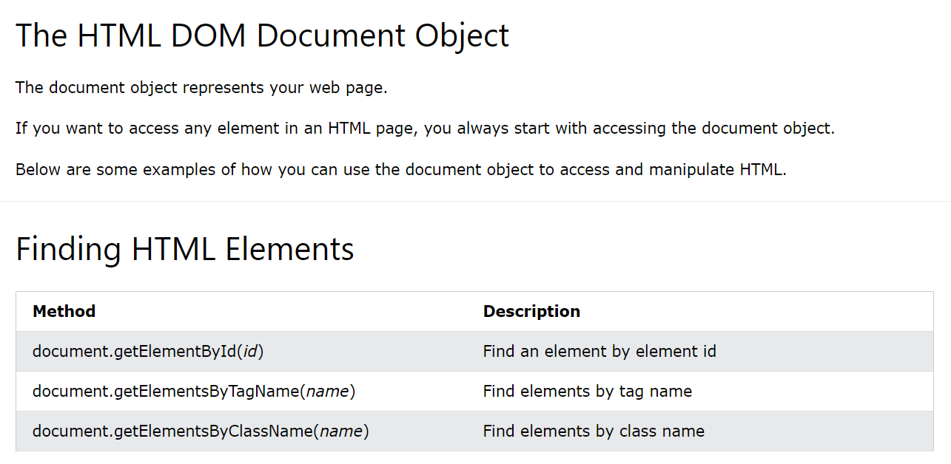

Slide 8
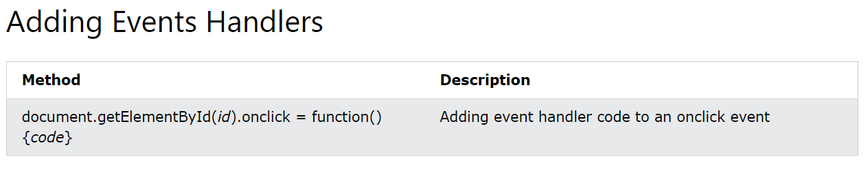

Slide 9
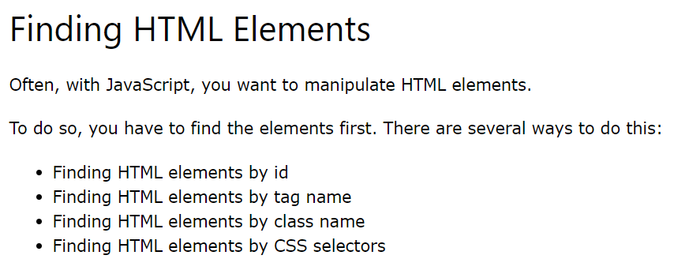
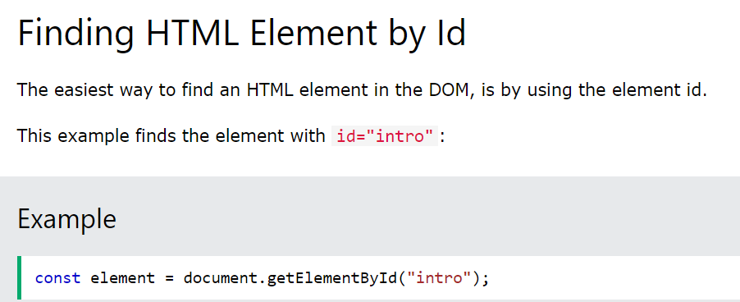

Slide 10
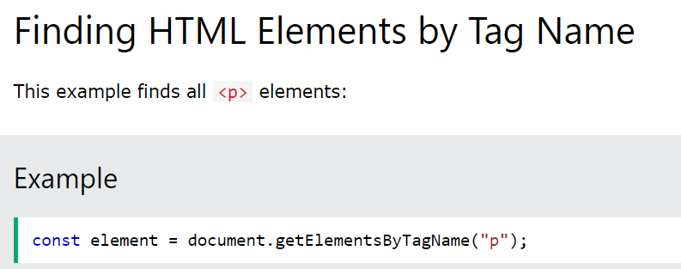
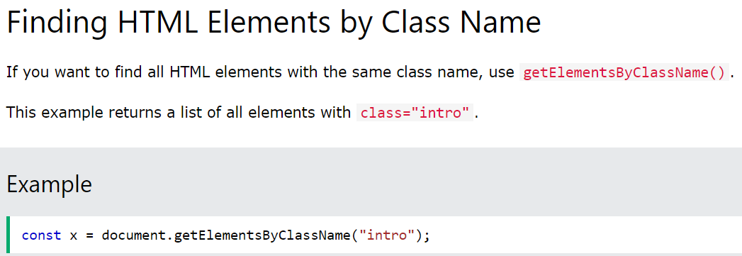

Slide 11
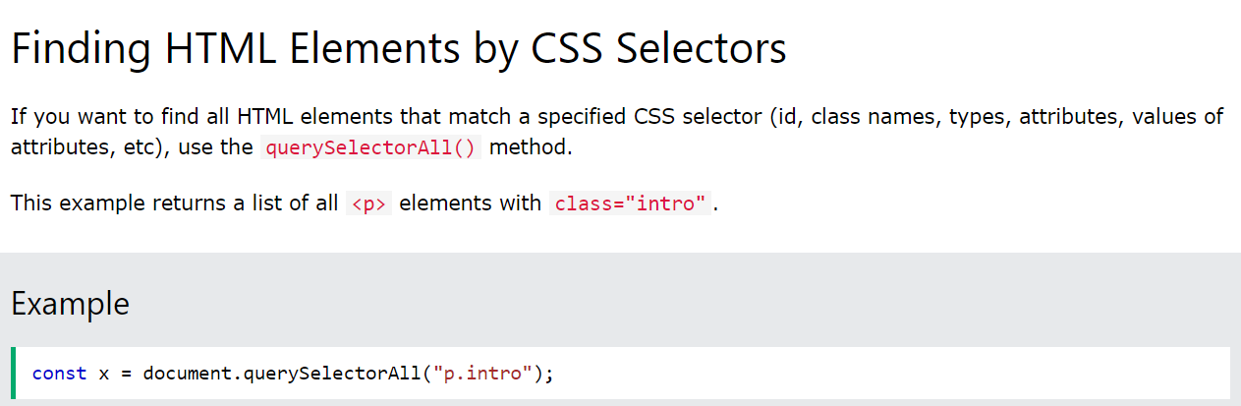

Slide 12
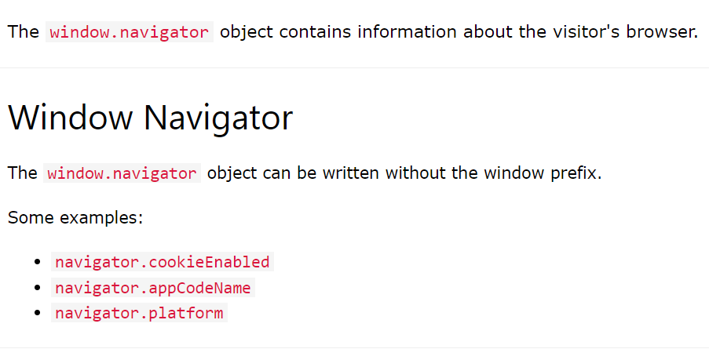
Window Object

Slide 13
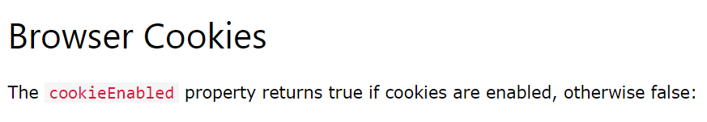
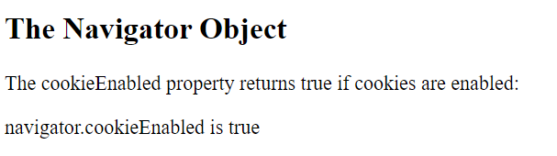
<!DOCTYPE html>
<html>
<body>
<h2>The Navigator Object</h2>
<p>The cookieEnabled property returns true if cookies are enabled:</p>
<p id="demo"></p>
<script>
document.getElementById("demo").innerHTML =
"navigator.cookieEnabled is " + navigator.cookieEnabled;
</script>
</body>
</html>

Slide 14
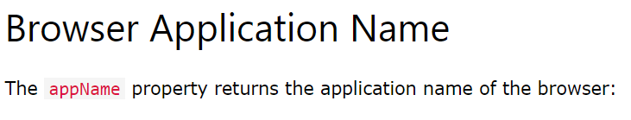
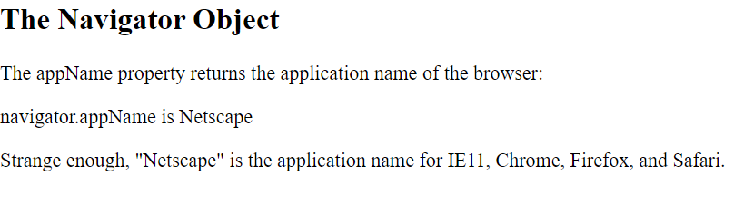
<!DOCTYPE html>
<html>
<body>
<h2>The Navigator Object</h2>
<p>The appName property returns the application name of the browser:</p>
<p id="demo"></p>
<p>Strange enough, "Netscape" is the application name for IE11, Chrome, Firefox, and Safari.</p>
<script>
document.getElementById("demo").innerHTML =
"navigator.appName is " + navigator.appName;
</script>
</body>
</html>

Slide 15
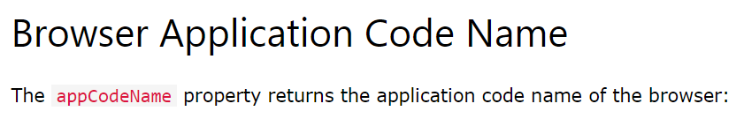
<html>
<body>
<h2>JavaScript Navigator</h2>
<p>The appCodeName property returns the code name of the browser.</p>
<p>Do not rely on it! "Mozilla" is the application code name for Chrome, Firefox, IE, Safari, and Opera.</p>
<p id="demo"></p>
<script>
document.getElementById("demo").innerHTML =
"navigator.appCodeName is " + navigator.appCodeName;
</script>
</body>
</html>

Slide 16
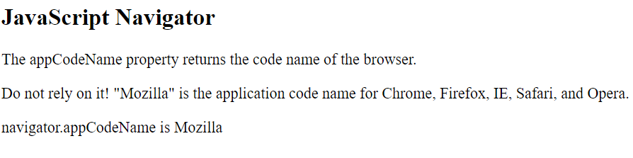
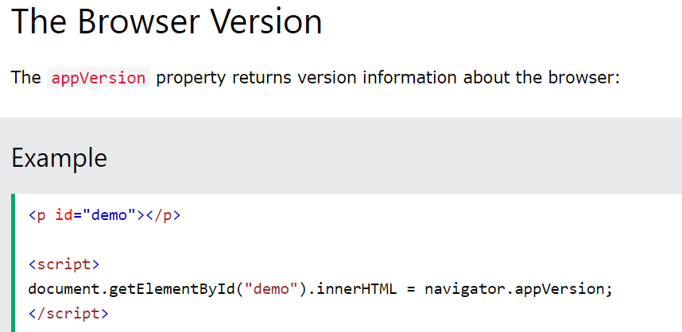

Slide 17
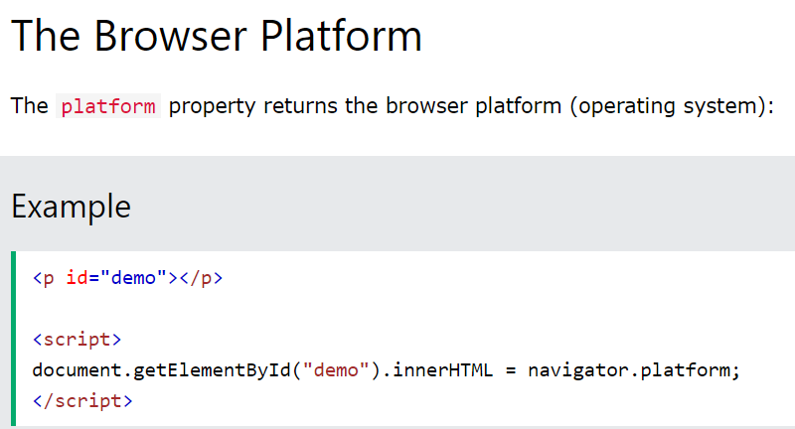
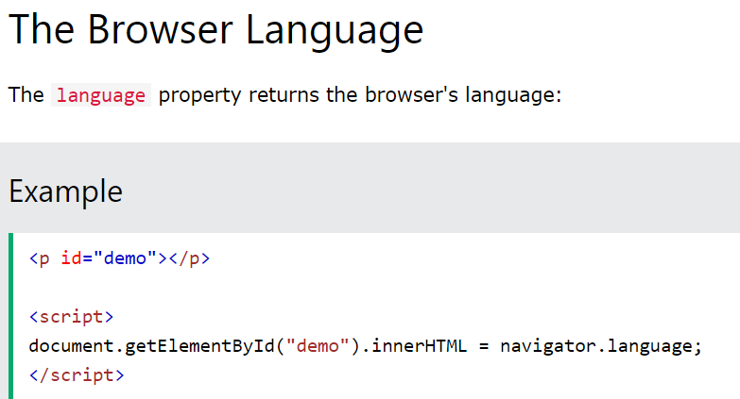

Slide 18
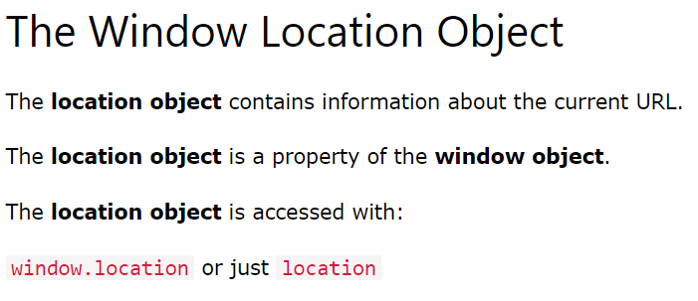
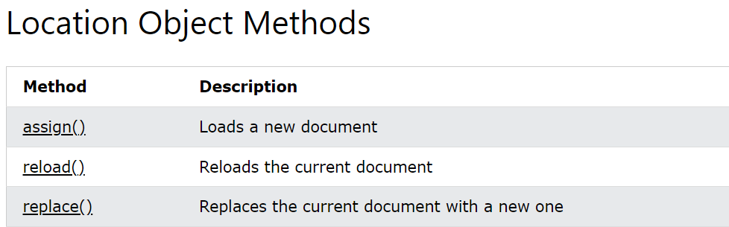

Slide 19
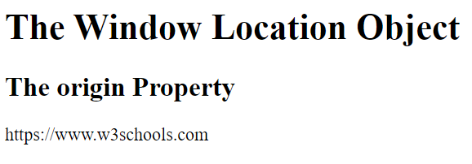
<html>
<body>
<h1>The Window Location Object</h1>
<h2>The origin Property</h2>
<p id="demo"></p>
<script>
let origin = window.location.origin;
document.getElementById("demo").innerHTML = origin;
</script>
</body>
</html>

Slide 20

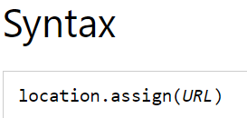
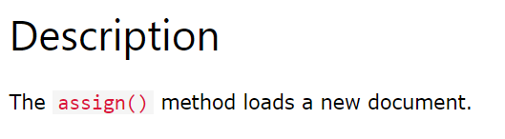
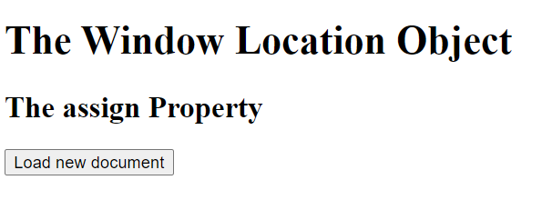
<html>
<body>
<h1>The Window Location Object</h1>
<h2>The assign Property</h2>
<button onclick="myFunction()">Load new document</button>
<script>
function myFunction() {
location.assign("https://www.w3schools.com");
}
</script>
</body>
</html>

Slide 21

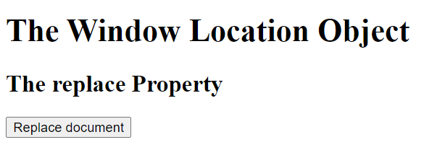
<html>
<body>
<h1>The Window Location Object</h1>
<h2>The replace Property</h2>
<button onclick="myFunction()">Replace document</button>
<script>
function myFunction() {
location.replace("https://www.w3schools.com")
}
</script>
</body>
</html>

Slide 22
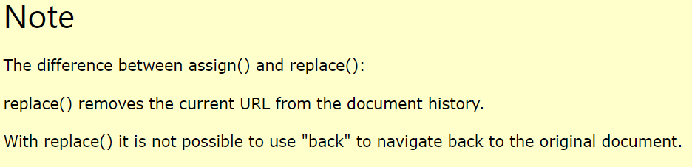

Slide 23

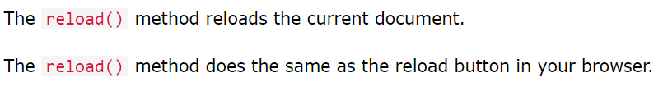
<html>
<body>
<h1>The Window Location Object</h1>
<h2>The reload Property</h2>
<script>
location.reload();
</script>
</body>
</html>

Slide 24
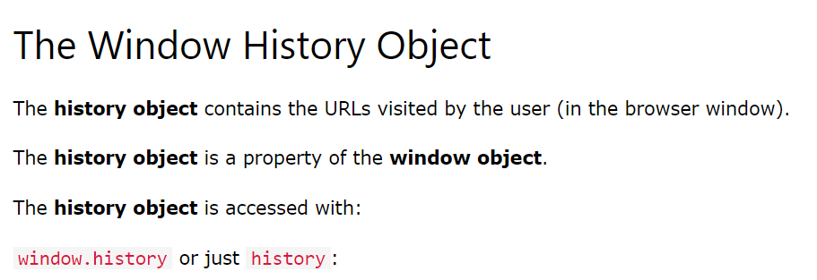
History Object

Slide 25
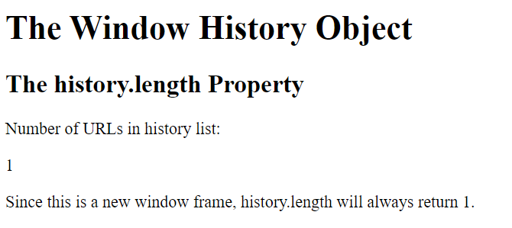
<!DOCTYPE html>
<html>
<body>
<h1>The Window History Object</h1>
<h2>The history.length Property</h2>
<p>Number of URLs in history list:</p>
<p id="demo"></p>
<p>Since this is a new window frame, history.length will always return 1.</p>
<script>
let length = history.length;
document.getElementById("demo").innerHTML = length;
</script>
</body>
</html>

Slide 26
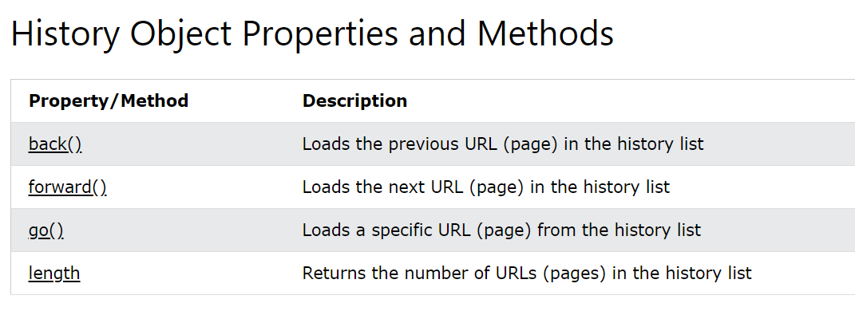

Slide 27

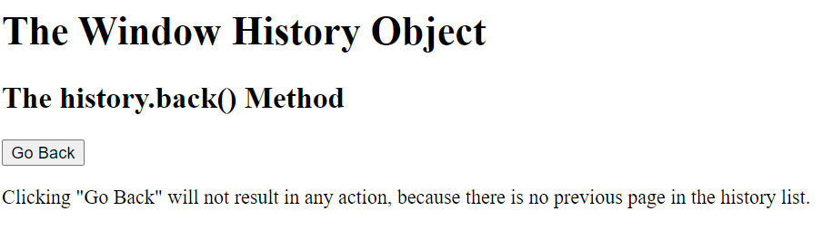
<body>
<h1>The Window History Object</h1>
<h2>The history.back() Method</h2>
<button onclick="history.back()">Go Back</button>
<p>Clicking "Go Back" will not result in any action, because there is no previous page in the history list.</p>
</body>

Slide 28
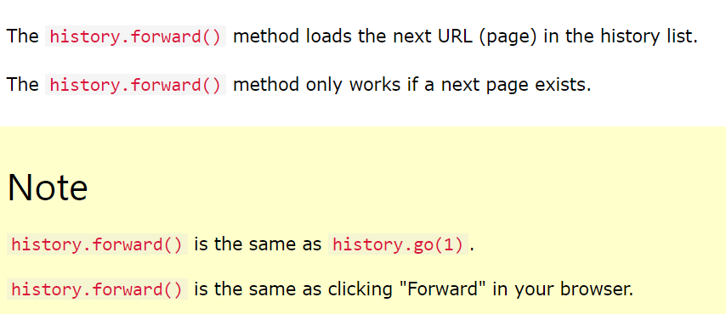
history.forward()

Slide 29
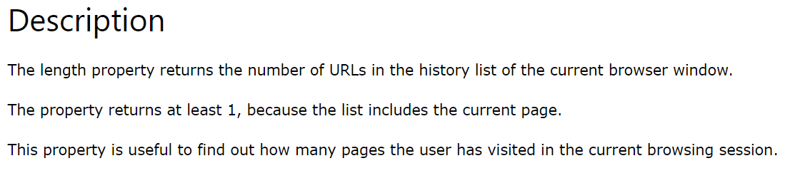
History.length

Slide 30
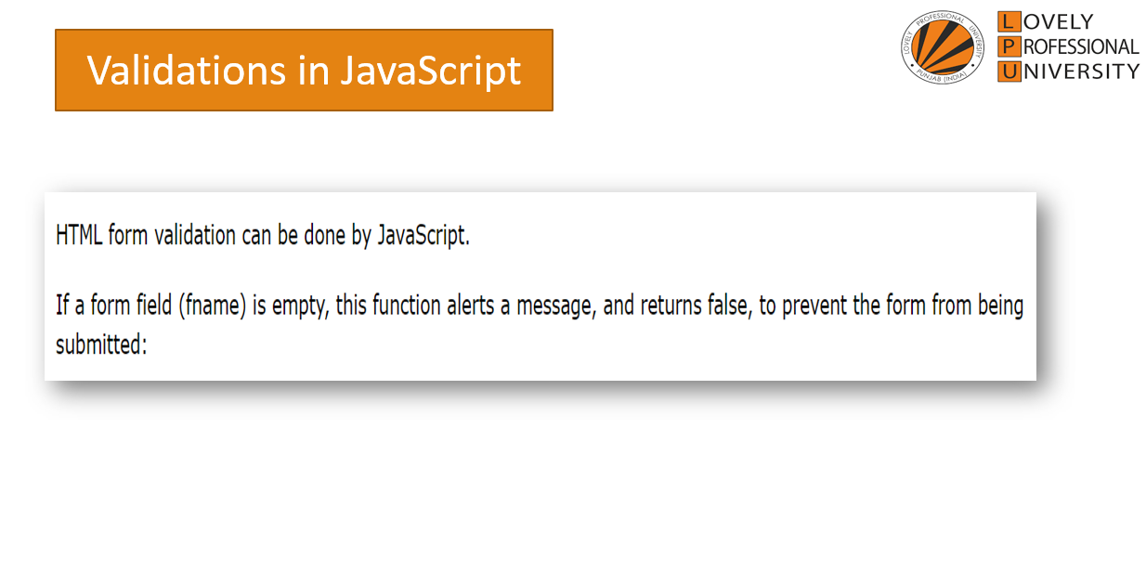

Slide 31
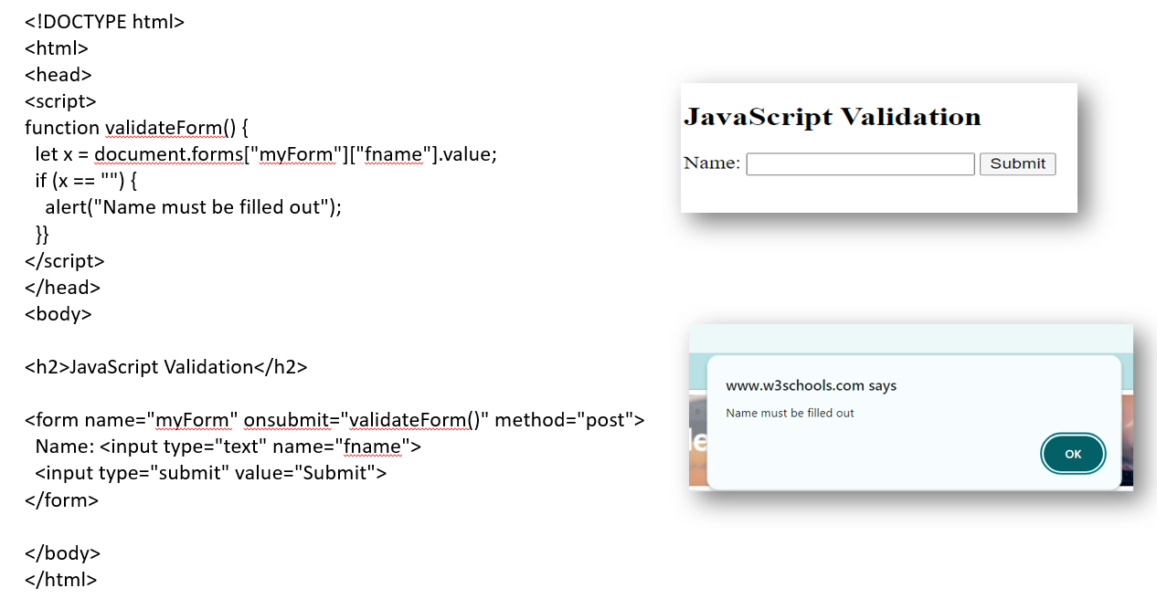

Slide 32
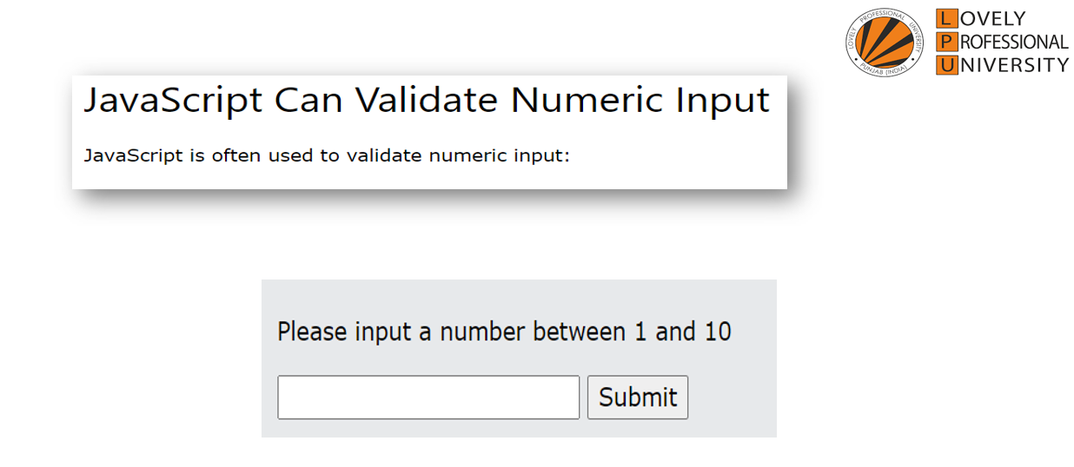

Slide 33
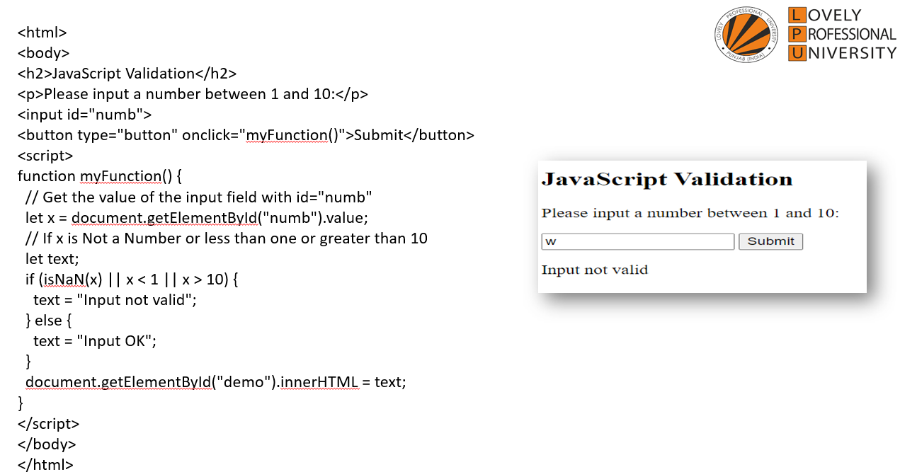

Slide 34
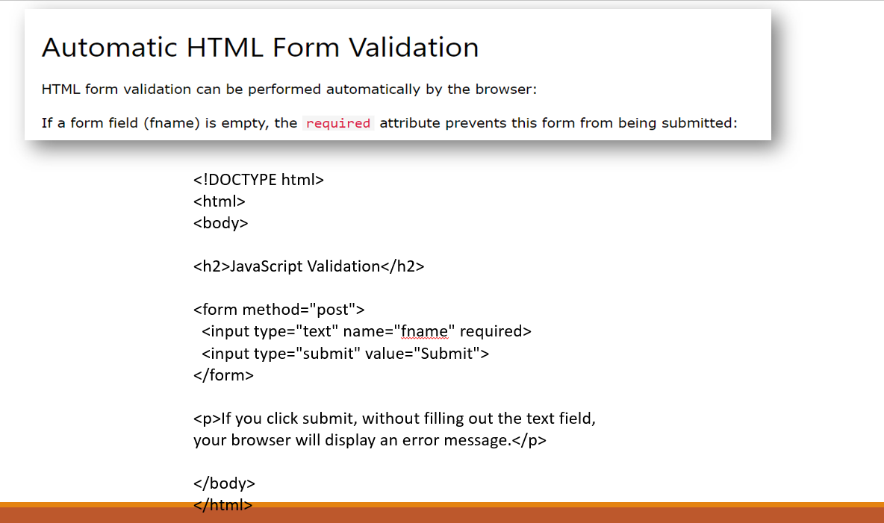

Slide 35
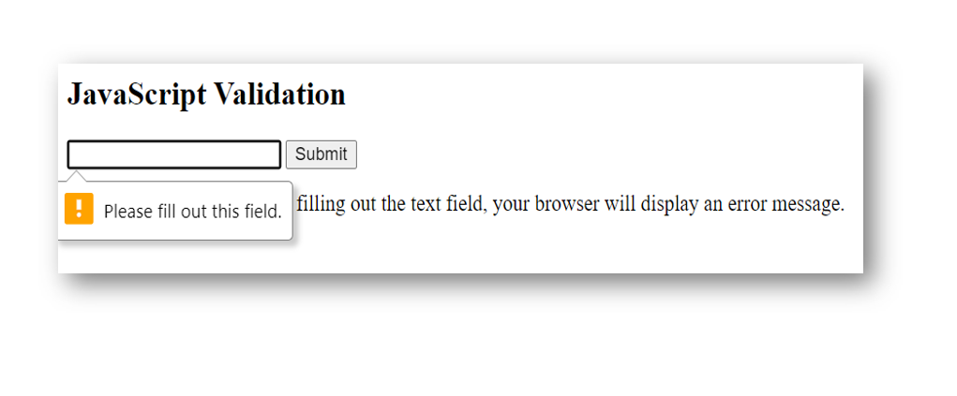

Slide 36
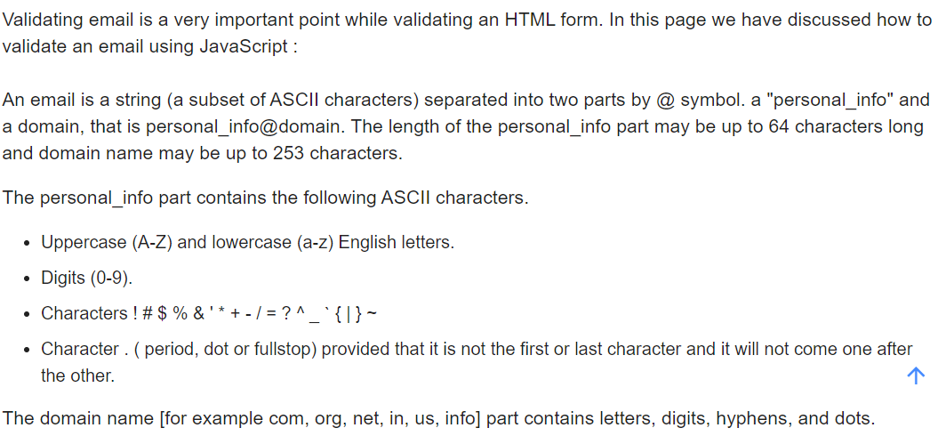
Email Validation

Slide 37
<!DOCTYPE html>
<html lang="en">
<head>
<meta charset="utf-8">
<title>JavaScript form validation - checking email</title>
<link rel='stylesheet' href='form-style.css' type='text/css' />
</head>
<body onload='document.form1.text1.focus()'>
<div class="mail">
<h2>Input an email and Submit</h2>
<form name="form1" action="#">
<ul>
<li><input type='text' name='text1'/></li>
<li>&nbsp;</li>
<li class="submit"><input type="submit" name="submit" value="Submit" onclick="ValidateEmail(document.form1.text1)"/></li>
<li>&nbsp;</li>
</ul>
</form>
</div>
<script src="email-validation.js"></script>
</body>
</html>
HTML Code

Slide 38
function ValidateEmail(inputText)
{
var mailformat = /^\w+([\.-]?\w+)*@\w+([\.-]?\w+)*(\.\w{2,3})+$/;
if(inputText.value.match(mailformat))
{
alert("Valid email address!");
document.form1.text1.focus();
return true;
}
else
{
alert("You have entered an invalid email address!");
document.form1.text1.focus();
return false;
}
}
JavaScript Code

Slide 39
Bootstrap
Bootstrap is a widely-used open-source front-end framework for web development, providing a collection of HTML, CSS, and JavaScript components and tools that enable developers to build responsive, mobile-first websites with ease.

Slide 40
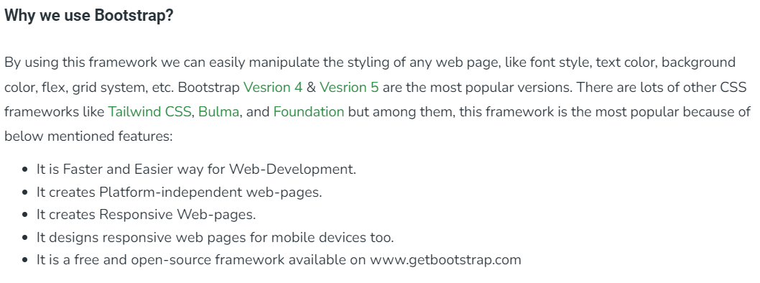

Slide 41
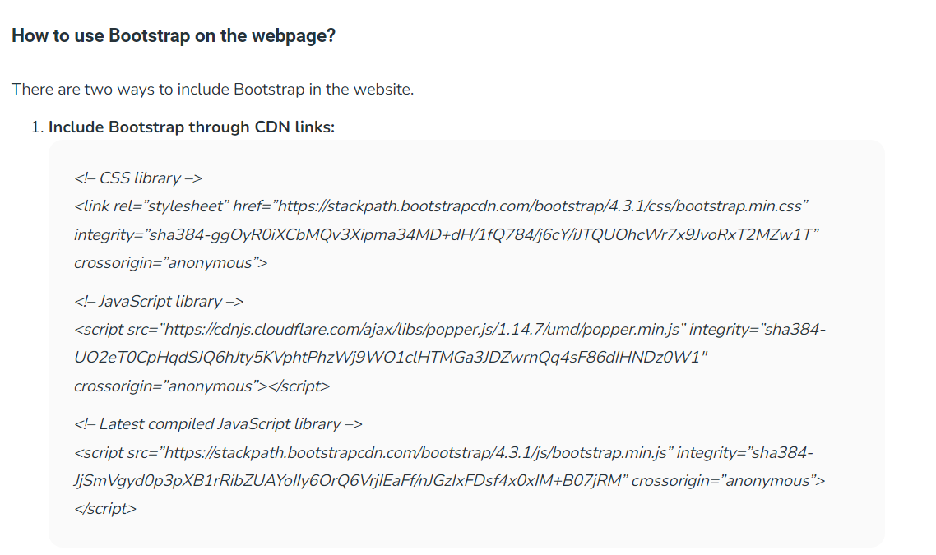

Slide 42
<!DOCTYPE html>
<html lang="en">
<head>
<title>Bootstrap Example</title>
<meta charset="utf-8">
<meta name="viewport" content="width=device-width, initial-scale=1">
<link href="https://cdn.jsdelivr.net/npm/bootstrap@5.1.1/dist/css/bootstrap.min.css" rel="stylesheet">
</head>
<body>
<div class="bg-primary text-white p-5 text-center">
<h1>My First Bootstrap Page</h1>
<p>Resize this page to see the responsive effect!</p>
</div>
<div class="container">
<div class="row">
<div class="col-sm-4">
<h2>London</h2>
<p>London is the most populous city in the United Kingdom,
with a metropolitan area of over 13 million inhabitants.</p>
</div>
<div class="col-sm-4">
<h2>Paris</h2>
<p>The Paris area is one of the largest population centers in Europe,
ith more than 12 million inhabitants.</p>
</div>
<div class="col-sm-4">
<h2>Tokyo</h2>
<p>Tokyo is the center of the Greater Tokyo Area,
and the most populous metropolitan area in the world.</p>
</div>
</div>
</div></body>
</html>

Slide 43
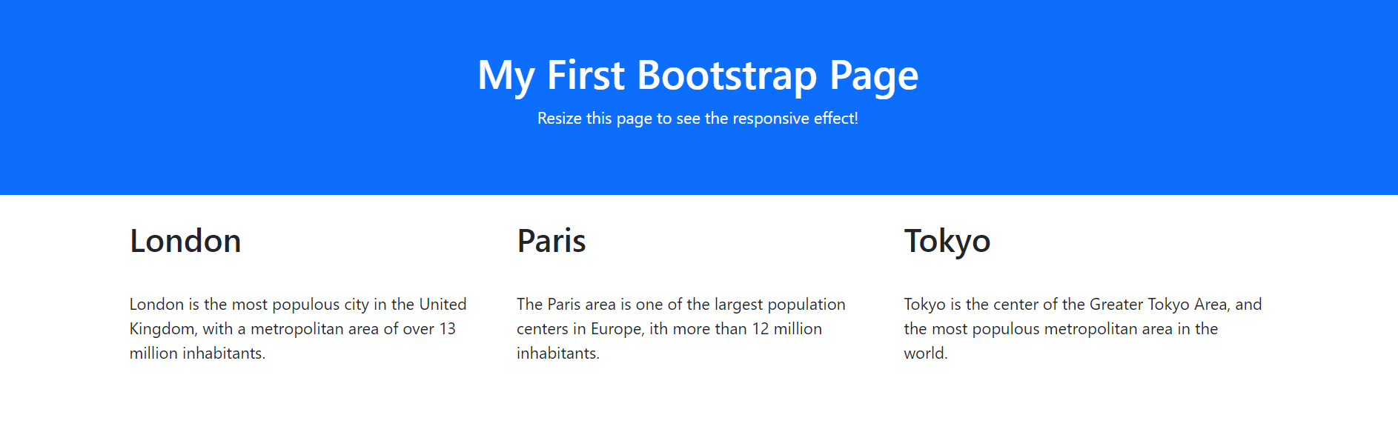

Slide 44
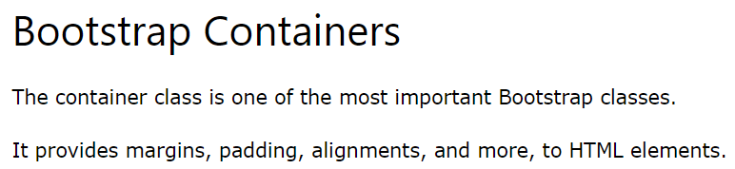
<html lang="en">
<head>
<title>Bootstrap Example</title>
<meta charset="utf-8">
<meta name="viewport" content="width=device-width, initial-scale=1">
<link href="https://cdn.jsdelivr.net/npm/bootstrap@5.1.1/dist/css/bootstrap.min.css" rel="stylesheet">
<script src="https://cdn.jsdelivr.net/npm/bootstrap@5.1.1/dist/js/bootstrap.bundle.min.js"></script>
</head>
<body>
<div>
<h2>Without a Container</h2>
<p>The container class is one of the most important Bootstrap classes.</p>
<p>It provides margins, padding, alignments, and more, to HTML elements.</p>
</div>
<div class="container-fluid">
<h2>With a Container</h2>
<p>The container class is one of the most important Bootstrap classes.</p>
<p>It provides margins, padding, alignments, and more, to HTML elements.</p>
</div>

Slide 45


Slide 46

<body><div class="container mt-3">
<h2>Bootstrap Colors</h2>
</div><div class="container bg-primary text-white p-4">
<p>London is the most populous city in the United Kingdom, with a metropolitan area of over 9 million inhabitants.</p>
</div>
<div class="container bg-success text-white p-4">
<p>London is the most populous city in the United Kingdom, with a metropolitan area of over 9 million inhabitants.</p>
</div>
<div class="container bg-info text-white p-4">
<p>London is the most populous city in the United Kingdom, with a metropolitan area of over 9 million inhabitants.</p>
</div>
<div class="container bg-warning text-white p-4">
<p>London is the most populous city in the United Kingdom, with a metropolitan area of over 9 million inhabitants.</p>
</div>
<div class="container bg-danger text-white p-4">
<p>London is the most populous city in the United Kingdom, with a metropolitan area of over 9 million inhabitants.</p>
</div>
<div class="container bg-secondary text-white p-4">
<p>London is the most populous city in the United Kingdom, with a metropolitan area of over 9 million inhabitants.</p>
</div>
<div class="container bg-dark text-white p-4">
<p>London is the most populous city in the United Kingdom, with a metropolitan area of over 9 million inhabitants.</p>
</div></body>

Slide 47



Slide 48



Slide 49

<body>
<div class="container-fluid">
<h1>Hello World!</h1>
<p>Three equal width columns! Try to add a new div with class="col" inside the row class - this will create four equal-width columns.</p>
<div class="row">
<div class="col" style="background-color:lavender;">.col</div>
<div class="col" style="background-color:orange;">.col</div>
<div class="col" style="background-color:lavender;">.col</div>
</div>
</div>
</body>

Slide 50

OUTPUT

Slide 51


Slide 52
<tr><th>Firstname</th>
<th>Lastname</th>
<th>Email</th>
</tr>
</thead>
<tbody>
<tr>
<td>John</td>
<td>Doe</td>
<td>john@example.com</td>
</tr>
<tr>
<td>Mary</td>
<td>Moe</td>
<td>mary@example.com</td>
</tr> <tr>
<td>July</td>
<td>Dooley</td>
<td>july@example.com</td>
</tr>
</tbody>
</table>
</div>/body>
</html>
<!DOCTYPE html>
<html lang="en">
<head>
<title>Bootstrap Example</title>
<meta charset="utf-8">
<meta name="viewport" content="width=device-width, initial-scale=1">
<link href="https://cdn.jsdelivr.net/npm/bootstrap@5.1.1/dist/css/bootstrap.min.css" rel="stylesheet">
<script src="https://cdn.jsdelivr.net/npm/bootstrap@5.1.1/dist/js/bootstrap.bundle.min.js"></script>
</head>
<body>
<div class="container">
<h2>Bordered Table</h2>
<p>The table-striped creates zebra-striped rows.</p>
<p>The table-bordered class adds borders to all cells.</p>
<table class="table table-striped table-bordered">
<thead>

Slide 53

Bootstrap Alerts
class="alert alert-danger
class="alert alert-warning
class="alert alert-success"

Slide 54



Slide 55
Bootstrap Cards
<div class="container">
<h2>Card Classes</h2>
<p>The card class is suitable for both images and notes:</p>
<div class="card" style="width:300px">
<img src="img_avatar1.png" alt="Image" style="width:100%">
<div class="card-body">
<h4 class="card-title">John Doe</h4>
<p class="card-text">Some example text some example text. John Doe is an architect and engineer</p>
<a href="#" class="btn btn-primary">See Profile</a>
</div>
</div>
</div>

Slide 56


Slide 57
Bootstrap Components
Bootstrap 4 provides a variety of customizable and reusable components which makes the development faster and easier.
They are heavily based on the base modifier nomenclature i.e. the base class has many groups of shared properties together while the modifier class has a group of individual styles.
For example, .btn is a base class and .btn-primary or .btn-success is a modifier class. The bootstrap components range from alerts, buttons, badges, cards to various other components.

Slide 58


Slide 59


Slide 60

Examples:- https://www.geeksforgeeks.org/explain-the-components-of-bootstrap/

Slide 61
Carousel
The Carousel is a slideshow for cycling through elements.
<html lang="en">
<head>
<title>Bootstrap Example</title>
<meta charset="utf-8">
<meta name="viewport" content="width=device-width, initial-scale=1">
<link rel="stylesheet" href="https://cdn.jsdelivr.net/npm/bootstrap@4.6.2/dist/css/bootstrap.min.css">
<script src="https://cdn.jsdelivr.net/npm/jquery@3.7.1/dist/jquery.slim.min.js"></script>
<script src="https://cdn.jsdelivr.net/npm/popper.js@1.16.1/dist/umd/popper.min.js"></script>
<script src="https://cdn.jsdelivr.net/npm/bootstrap@4.6.2/dist/js/bootstrap.bundle.min.js"></script>
<style>
/* Make the image fully responsive */
.carousel-inner img {
width: 100%;
height: 100%;
}
</style>
</head>

Slide 62
<body>
<div id="demo" class="carousel slide" data-ride="carousel">
<!-- Indicators -->
<ul class="carousel-indicators">
<li data-target="#demo" data-slide-to="0" class="active"></li>
<li data-target="#demo" data-slide-to="1"></li>
<li data-target="#demo" data-slide-to="2"></li>
</ul>
<!-- The slideshow -->
<div class="carousel-inner">
<div class="carousel-item active">
<img src="la.jpg" alt="Los Angeles" width="1100" height="500">
</div>
<div class="carousel-item">
<img src="chicago.jpg" alt="Chicago" width="1100" height="500">
</div>
<div class="carousel-item">
<img src="ny.jpg" alt="New York" width="1100" height="500">
</div>
</div>
<!-- Left and right controls -->
<a class="carousel-control-prev" href="#demo" data-slide="prev">
<span class="carousel-control-prev-icon"></span>
</a>
<a class="carousel-control-next" href="#demo" data-slide="next">
<span class="carousel-control-next-icon"></span>
</a>
</div>
</body>
</html>

